Slide 1
MUSCLEHUB GYM
How fitness tests affect new memberships
(Educational Study - not real data or location, but the data is based on realistic trends)

Slide 2
Current Membership Process
If a visitor to MuscleHub gym expresses interest in becoming a member, they go through the following steps:
The visitor takes a fitness test with a personal trainer
Afterwards, they take an application to join the gym
Finally, they send in payment for the first month’s membership

Slide 3
Purpose of test
After receiving feedback, the manager of MuscleHub expressed concern that the fitness test may be intimidating potential members, reducing overall memberships.
This is the purpose of the test run in this exercise - to determine if asking a prospective member to take a fitness test will likely reduce the number of potential new members to MuscleHub gym.
Hypothesis: If visitors are not offered a fitness test, then they are more likely to purchase a membership at MuscleHub gym compared to visitors who are offered a fitness test.

Slide 4
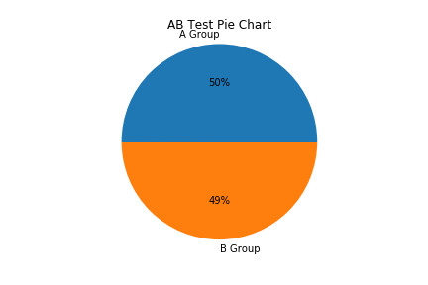
Data Collected
An A/B test of around 5,000 visitors was conducted - group A would be offered a fitness test if expressing interest in membership, while group B will proceed directly to application.
All visitors to the gym are ID’d in this test, with the following data logged: -Date of visit to MuscleHub gym -Date of fitness test (if in Group A) -Date of completed application (if one is filed) -Date of 1st monthly dues (if given by visitor)
As shown, the groups are nearly equal, at roughly 2500 visitors per group.

Slide 5
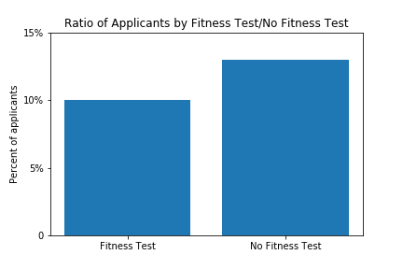
Results - Ratio of visitors taking Applications
-Of the visitors in Group A (those who were given a fitness test before applying), just under 10% turned in an application.
-Of the visitors in Group B (those who were not given a fitness test), 13% turned in an application. This is a significantly higher ratio of applicants found in Group B.

Slide 6
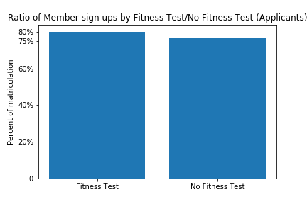
Results - Effects of Fitness test on Applicants
-In collected data, 80% of those in Group A who turned in an application also made a first month’s membership payment.
-By contrast, just under 77% of those in Group B who turned in an application also made a first month’s membership payment.
-Testing this figure could not prove any statistical significance. Therefore, it cannot be proven that fitness tests are more likely to encourage those who apply to MuscleHub gym to pay membership dues.

Slide 7
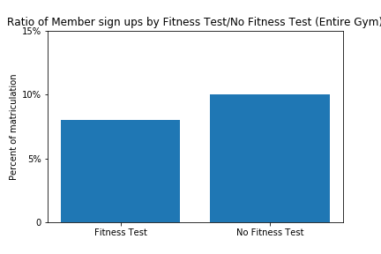
Result - Effects of Fitness test on gym population
-Out of all the visitors given a fitness test, just under 8% advanced to making a membership payment.
-Of all the visitors not given a fitness test, 10% advanced to making a membership payment.
-It can be demonstrated that this is a significantly higher rate of success in converting visitors into paying MuscleHub gym members.

Slide 8
Summary of Findings
Significantly more visitors who were not given a fitness test took an application than those who were given a fitness test.
There was no significantly higher success rate of visitors who already turned in an application offering membership payments when offered a fitness test.
Significantly more visitors to the gym advanced fully to making membership payments when not offered a fitness test compared with those who were offered a fitness test.
It is therefore the conclusion of this study that the hypothesis is confirmed, and that not offering a fitness test appears to increase the total number of new membership payments.

Slide 9
Recommendation
-It is the conclusion of this report that offering fitness tests to all visitors to MuscleHub gym that express interest in memberships has a negative impact on the number of new paying members, while having no discernable positive impact. It is therefore recommended that such tests either be made optional or not offered until after a visitor becomes a paid member.
-Further studies in the form of a survey could be conducted to isolate which demographic responds most favorably and most unfavorably with a fitness test, to better shape descriptions and advertisements of such tests to the most affected demographic.

